Slide 1
Electronic Attendance System Based On RFID

Slide 2

HELLO!
I am Bhavin Savaliya
I’m here today to present the final year project give presentations.

Slide 3

Submitted by Bhavin G Savaliya TYBCA PR NO 04417003554 Under the guidance of Prof. R. H. Gohel Prof. Hemchandra Kumbhar Prof. Usha Phadatare 2019-2020 Shailendra Education Society’s Computer Center (SESCOM), Mumbai 400 068. Tilak Maharashtra Vidyapeeth, Pune

Slide 4
What is RFID based attendance system?
Radio Frequency Identification based attendance system is an automatic attendance system which consists of a micro controller, RFID reader, RFID tag and a data base as its primary components.
RFID tag serves as a unique identification card for each student.
A student places his identification card in the proximity of RFID reader which detects the unique ID and student details present in the identification card.
Details of the students are stored in a data base.
This data can be used to record and maintain the attendance of the students/employees in class/organizations.

Slide 5
BLOCK DIAGRAM
PC
MICROCONTROLLER
RFID READER
RFID TAG
DATA BASE

Slide 6
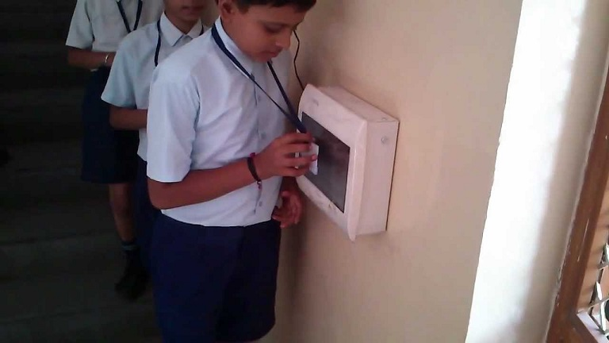
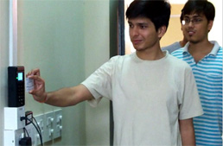

Slide 7
Advantages of RFID based Attendance system
Capability to store maximum records in real time.
In-built real time clock.
In-built communication interface for interpretation and processing of data.
Maximum reading range, transmitting signals at certain frequencies.
Auto attendance of students as student enters school/college rfid reader with student id card tag the machine frequency catch and send to the database.
Tracking, monitoring, and identification of students in school/college premise and in GPRS-enabled school/college buses in real time. (this feature is not added as a example)

Slide 8
Generation of attendance reports daily / monthly / quarterly / annually.
Keeping records of late arrival, early departure and time summary.
Storage of complete attendance data.
Easy transmission of information from the RFID tag to central backend management systems.

Slide 9
PROBLEMS OF EXISTING ATTENDANCE SYSTEMS
Roll call in educational institutions and offices consumes considerable amount of time and resources.
Schools/College can overcome this inefficiency and address the problem adopting RFID based attendance.
Though this traditional attendance management is still popular in many a school/college, the concept of the use of RFID based attendance system is gradually gaining momentum in city schools/colleges.
This stand-alone project aims to solve this problem by automating the attendance system which will automatically record the attendance.
The teacher need not maintain attendance records by manually calling out roll numbers or names of each student in class at the start of the day or after lunch hours.

Slide 10
Components:
Arduino UNO
RFID-RC522 Reader Module
RFID tags
Jump Wires

Slide 11
Working Principle
RFID – Radio Frequency Identification
The reader coil generates an electromagnetic field, which couples into the coil on the RFID tag (“transponder”).
The field generates a current in the transponder, which powers it, and also contains the transmitted data.

Slide 12
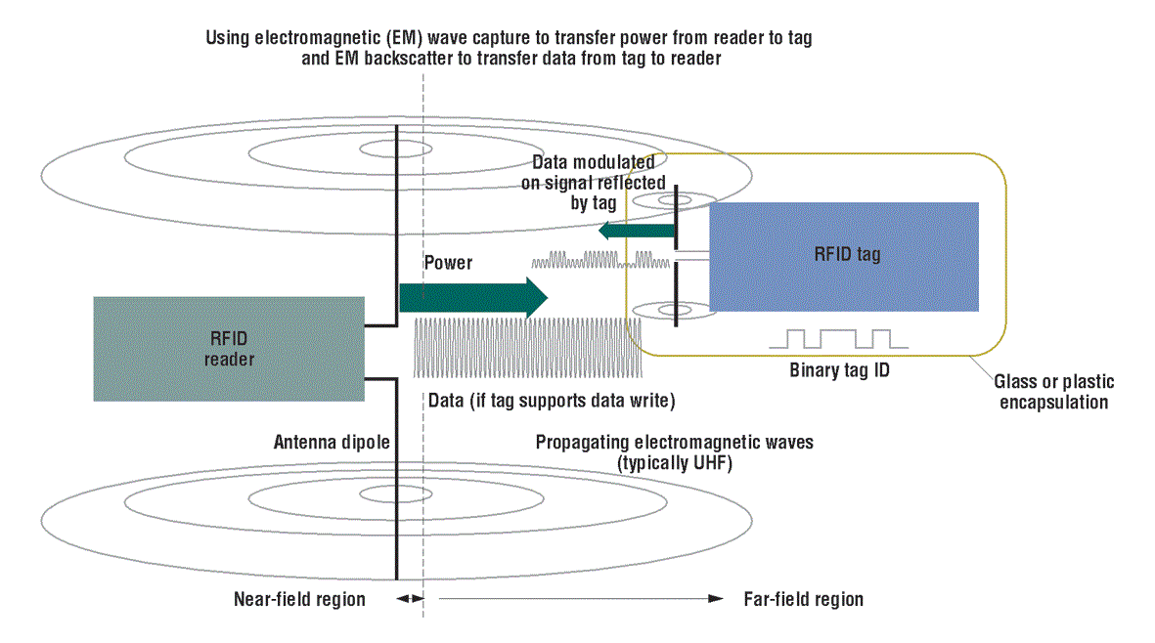
RFID Working Principle

Slide 13
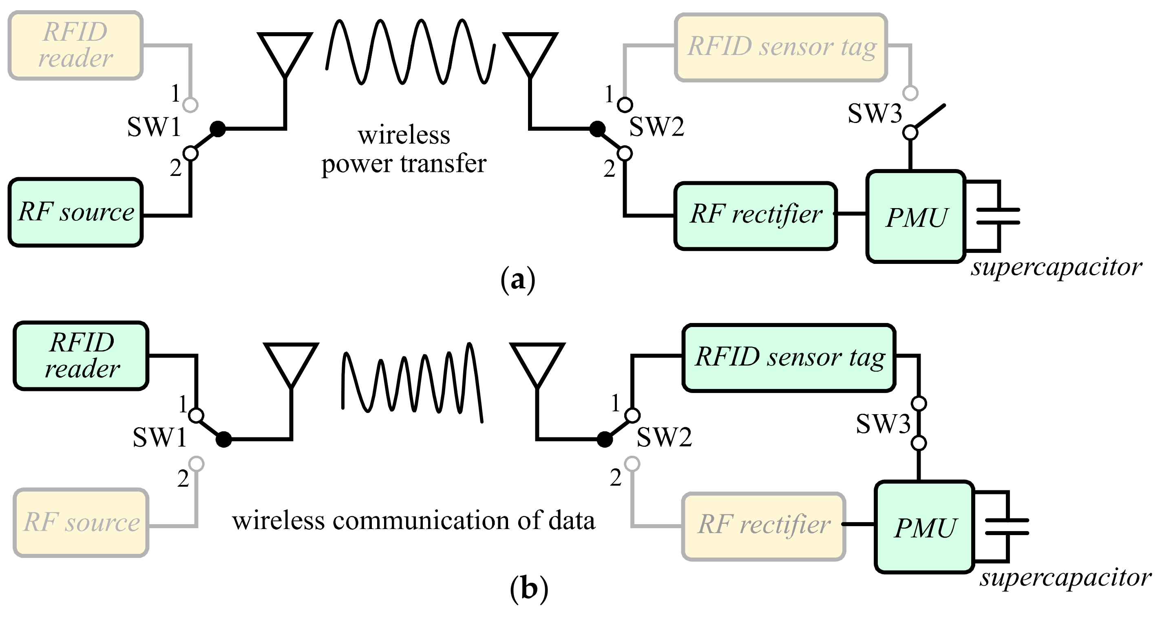
RFID Communication

Slide 14
Tag extracts power and the transmitted message.
The induced current in the tag antenna causes a transmission itself.
This re-transmission can be used to send data back to the reader
This is done by modulating the tag antenna load via a switch
(transistor). This modulates the current and with that the retransmitted wave.

Slide 15
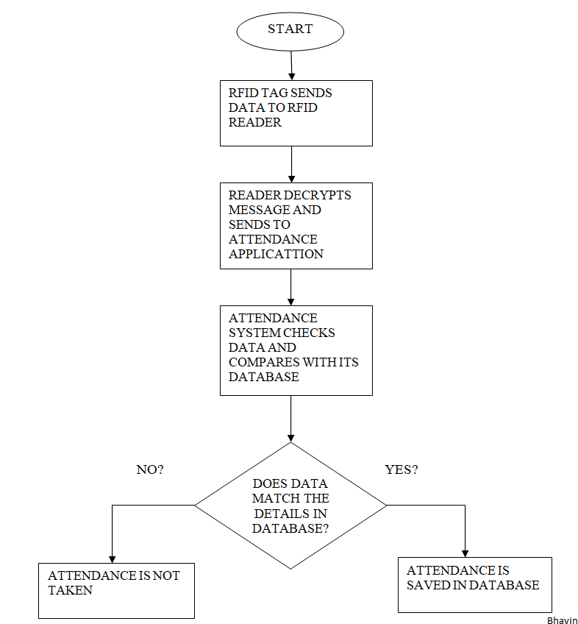
DATA PROCESSING FLOW CHART

Slide 16
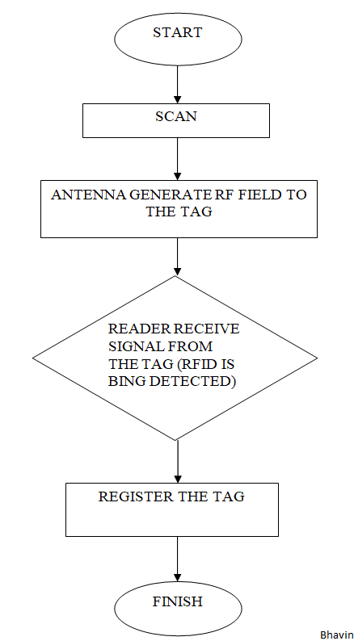
REGISTRATION PROCESSING FLOW CHART

Slide 17
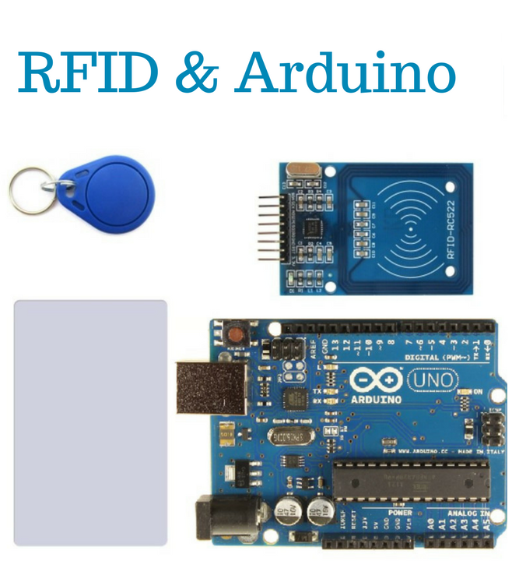
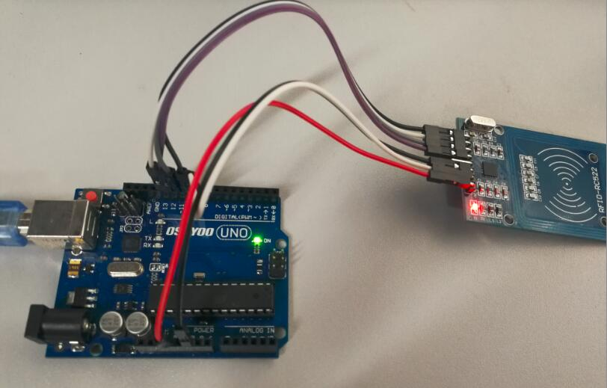
Components Screen…
Place yor screenshot here

Slide 18
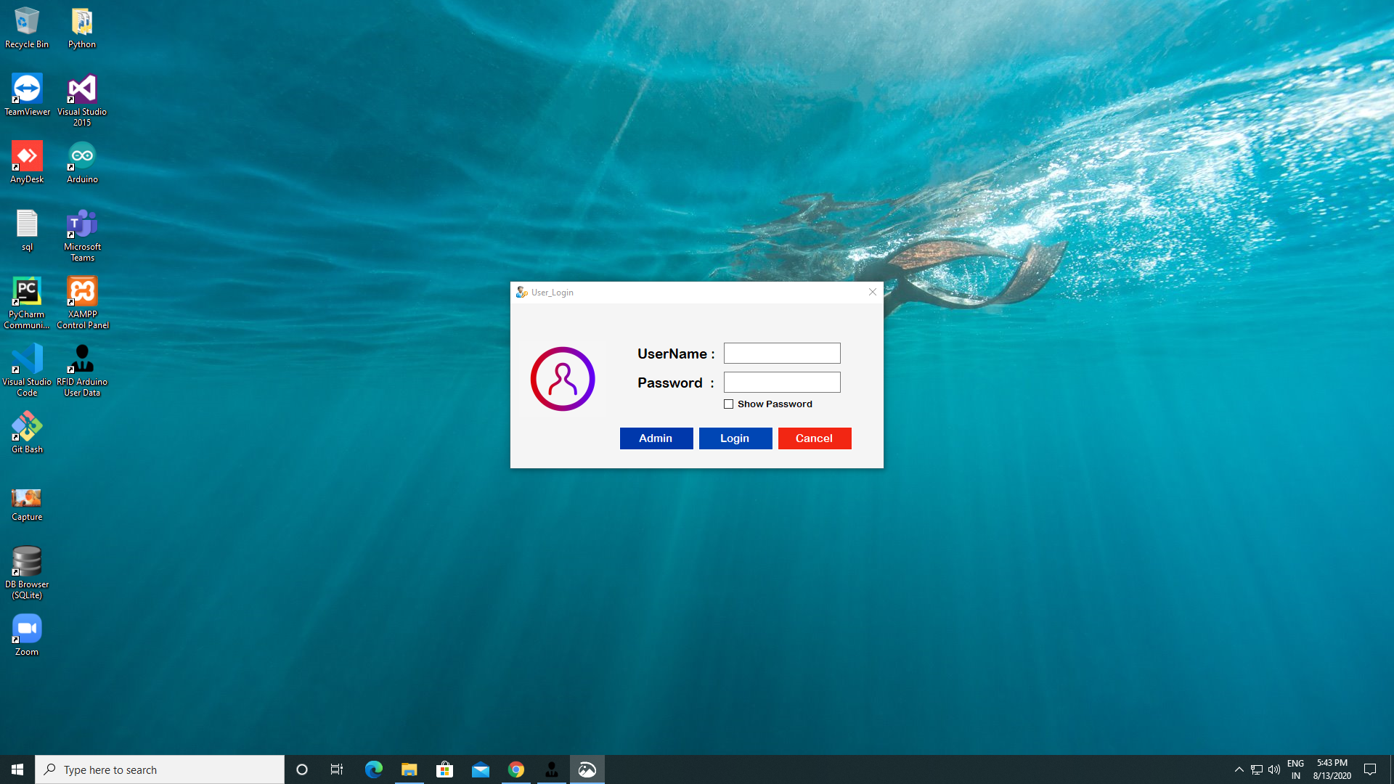
User Login Screen…
Place your screenshot here

Slide 19
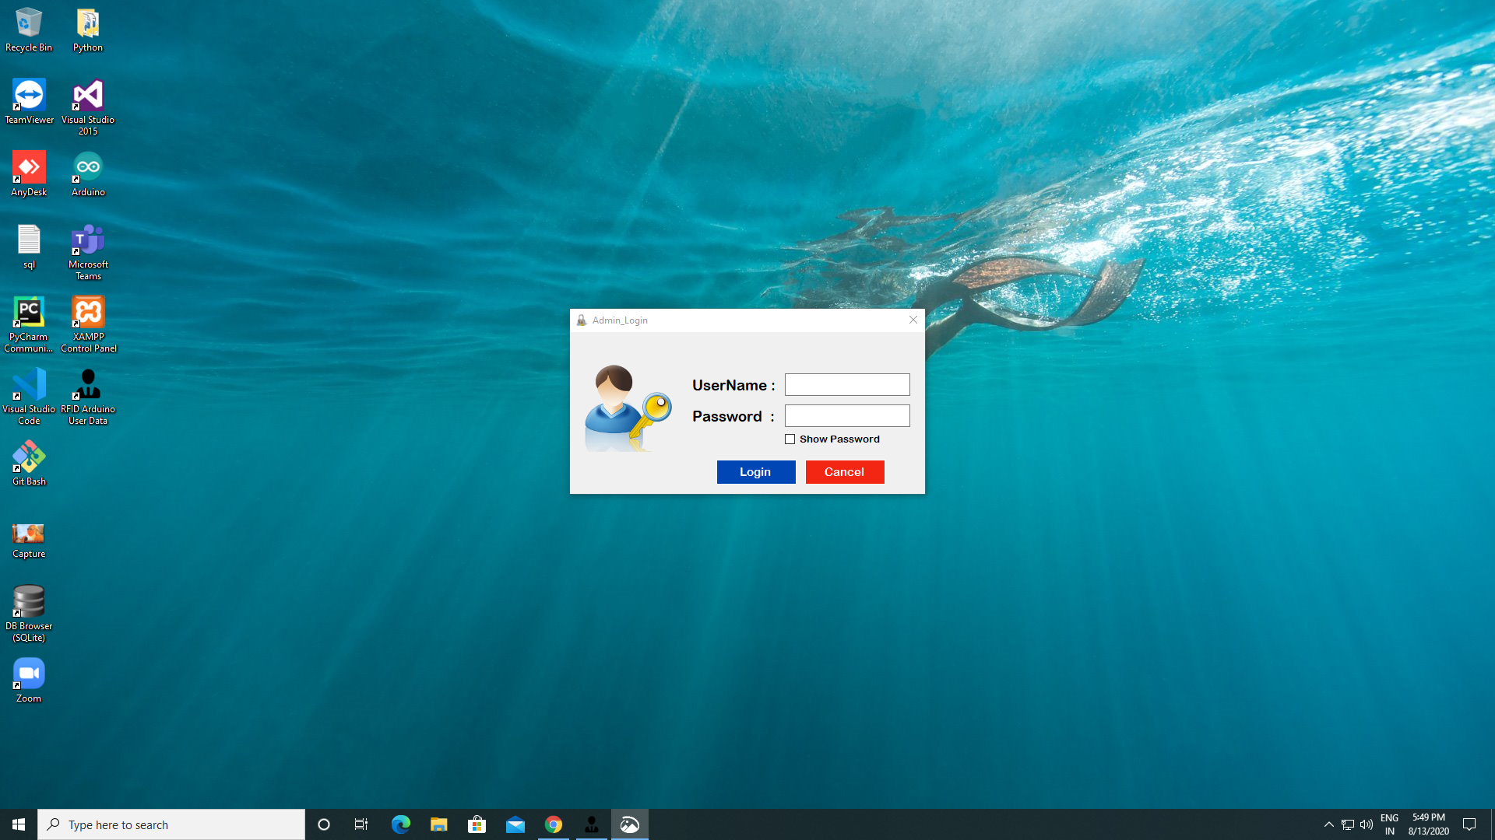
Admin Login Screen…
Place your screenshot here

Slide 20

Registration Screen…
Place your screenshot here

Slide 21
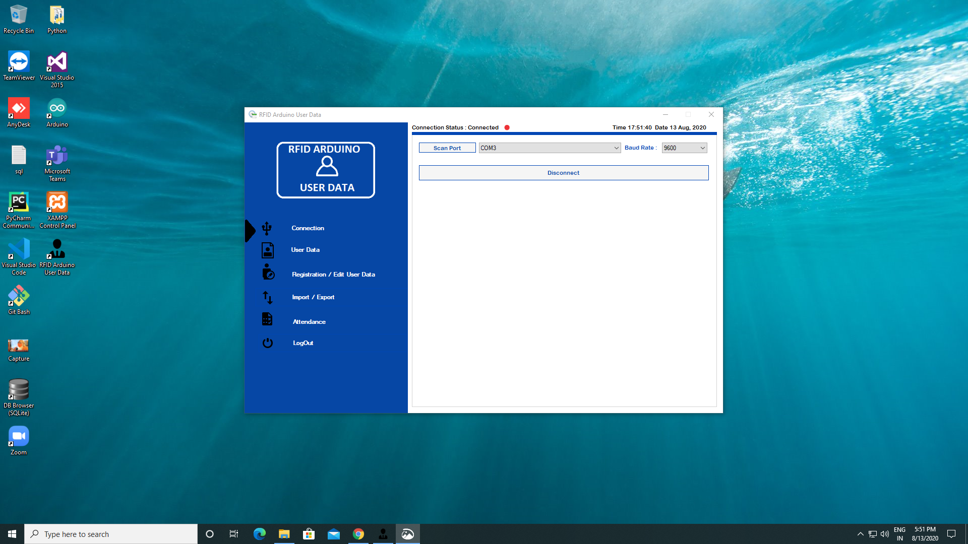
Connection Screen…
Place your screenshot here

Slide 22
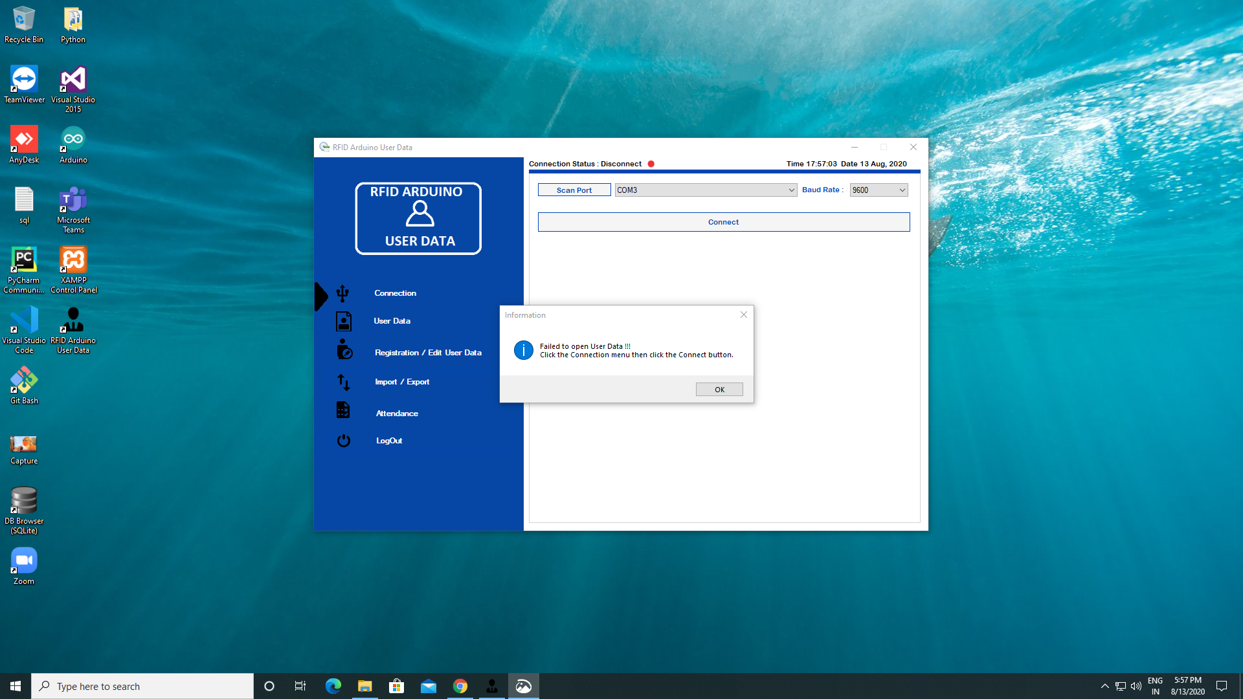
Disconnect
Screen…
Place your screenshot here

Slide 23
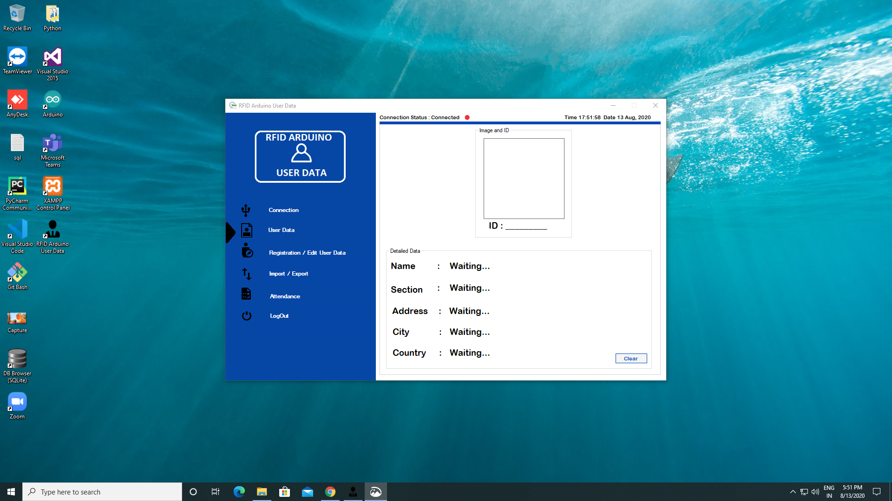
User Data
Screen…
Place your screenshot here

Slide 24
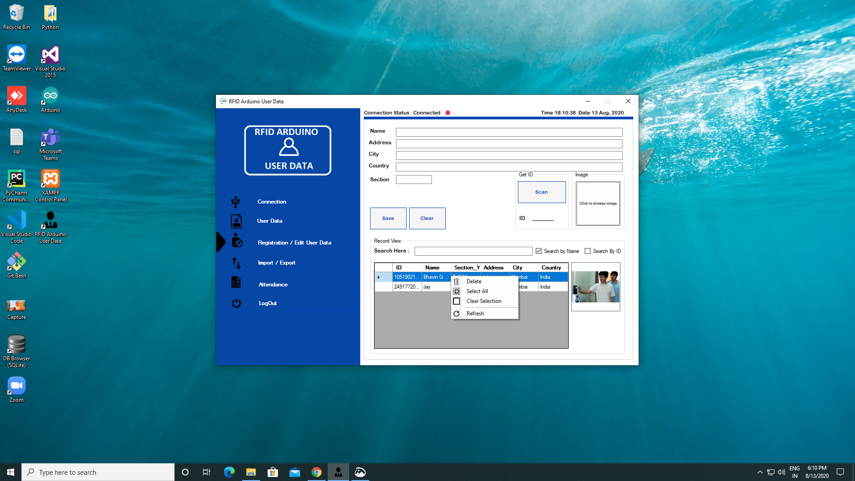
Registration/Edit User Data
Screen…
Place your screenshot here

Slide 25
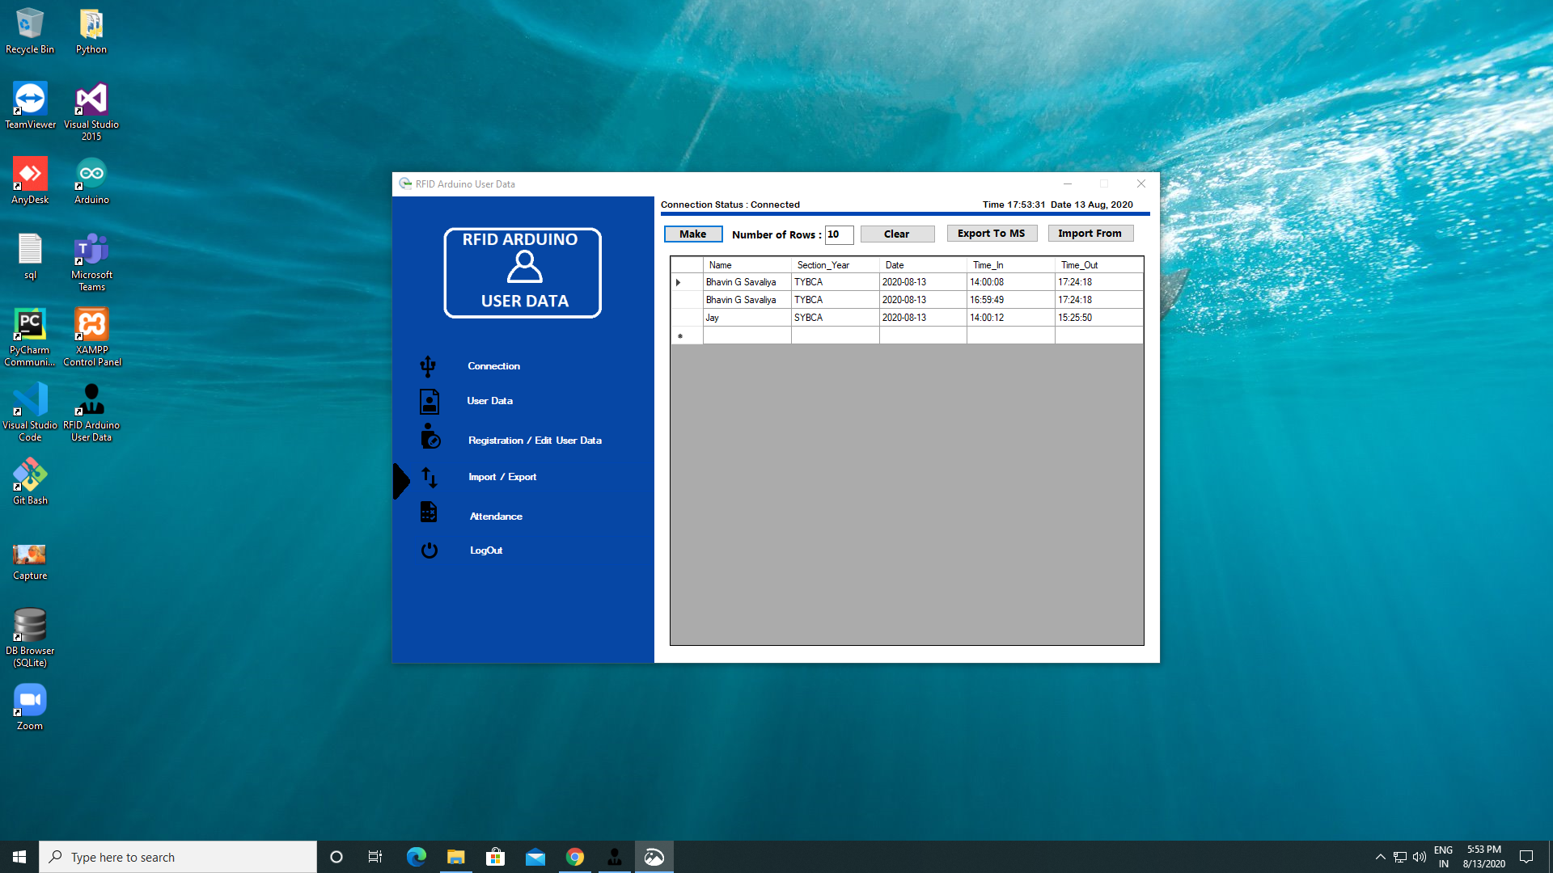
Import/ Export
Screen…
Place your screenshot here

Slide 26
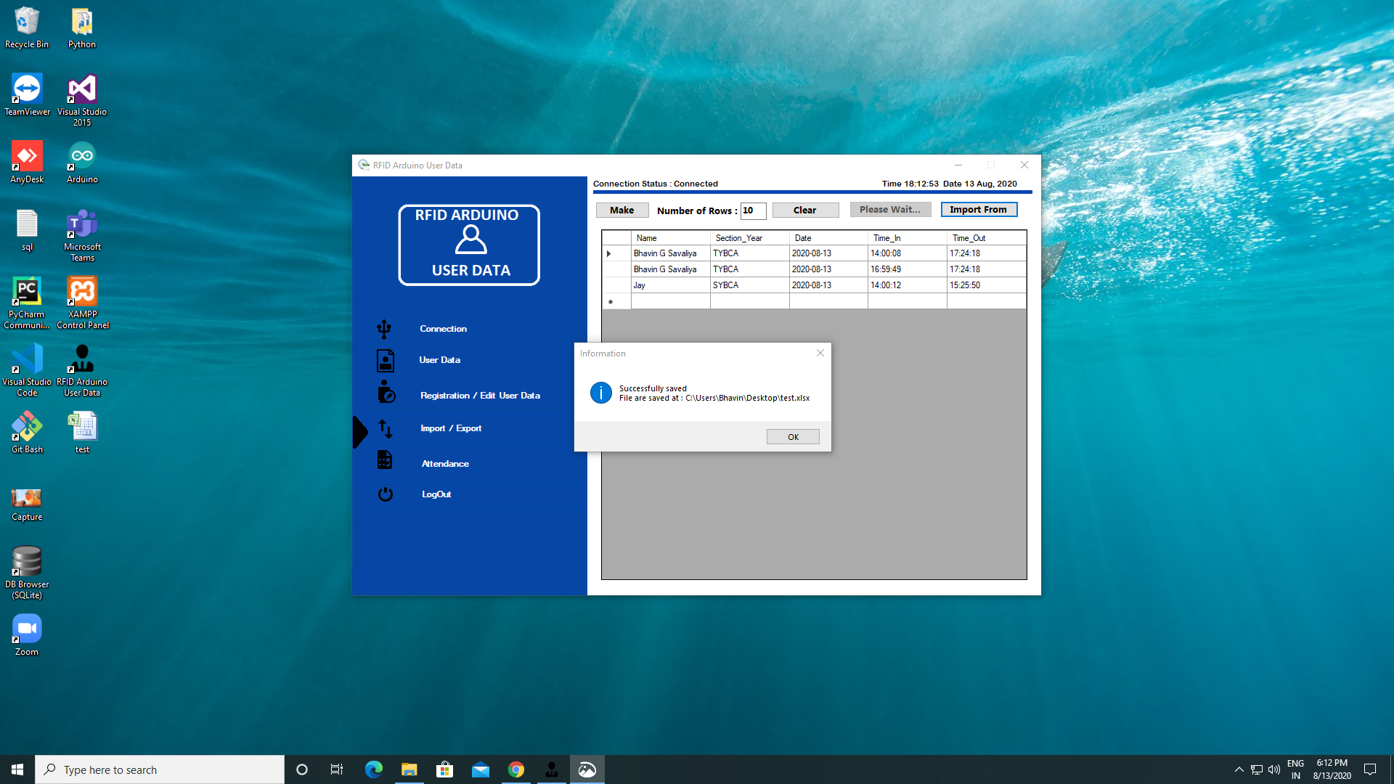
Import Saved Message
Screen…
Place your screenshot here

Slide 27
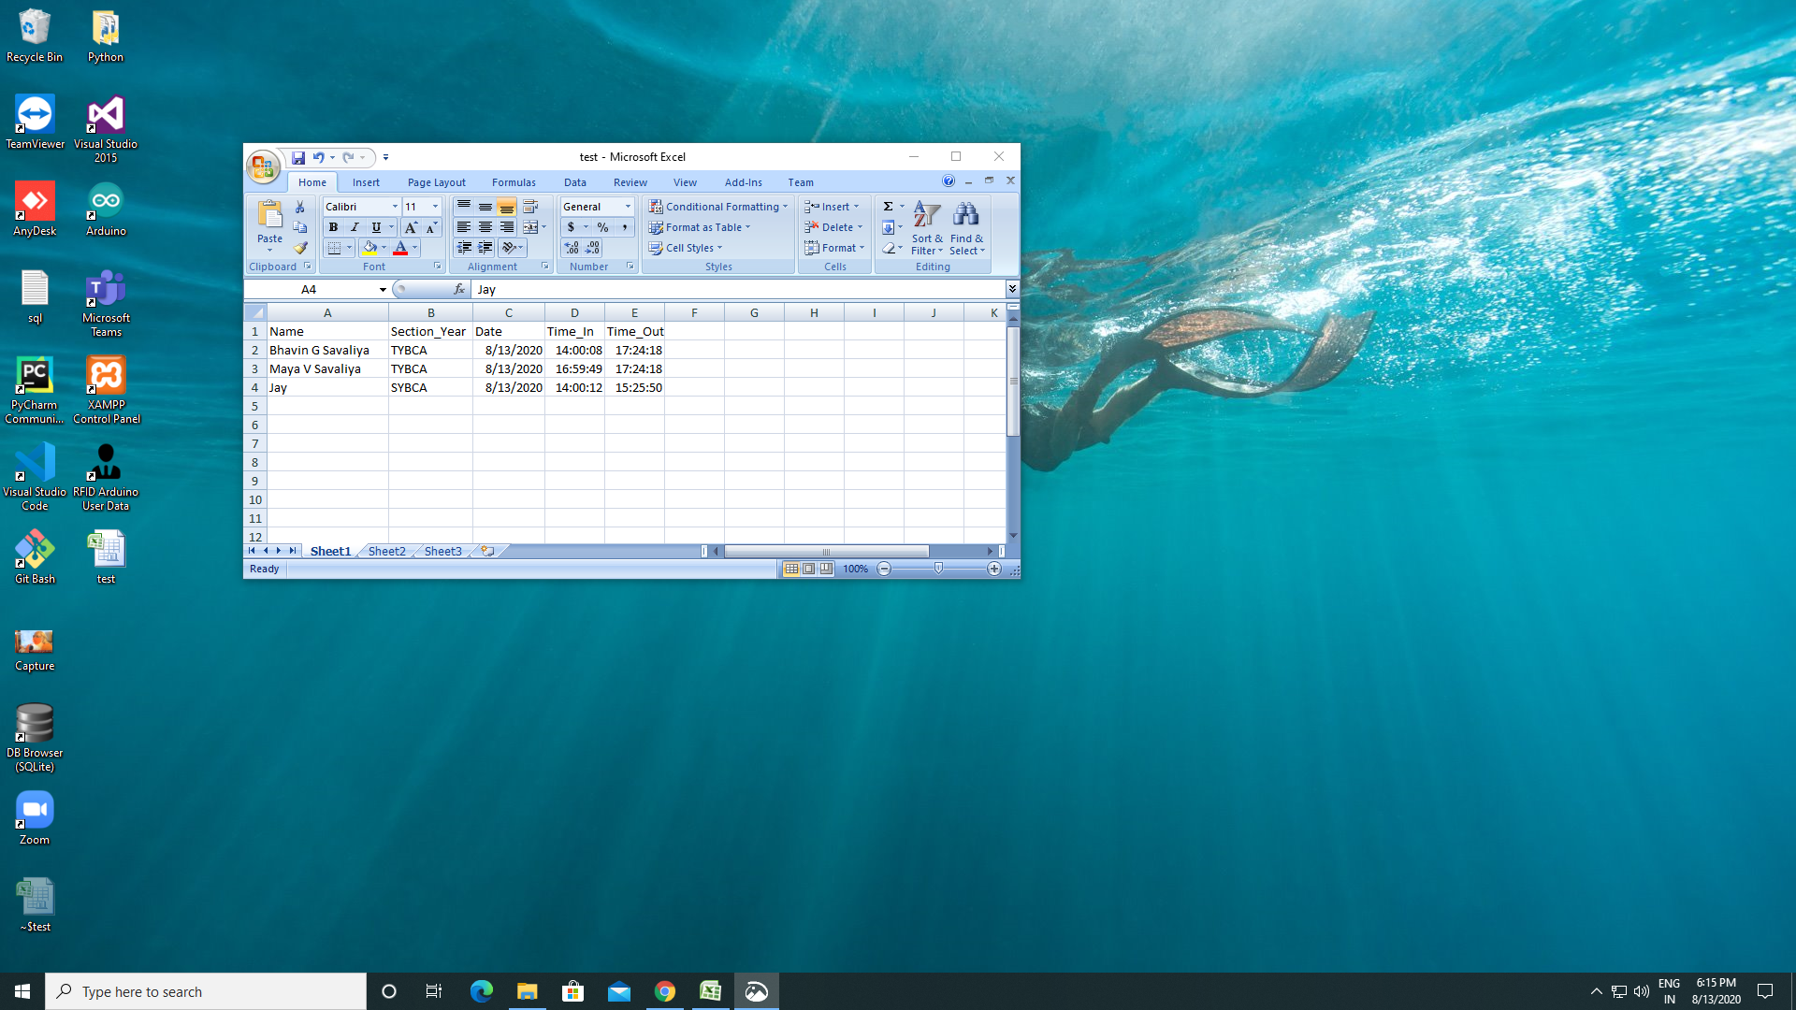
Excel
Screen…
Place your screenshot here

Slide 28
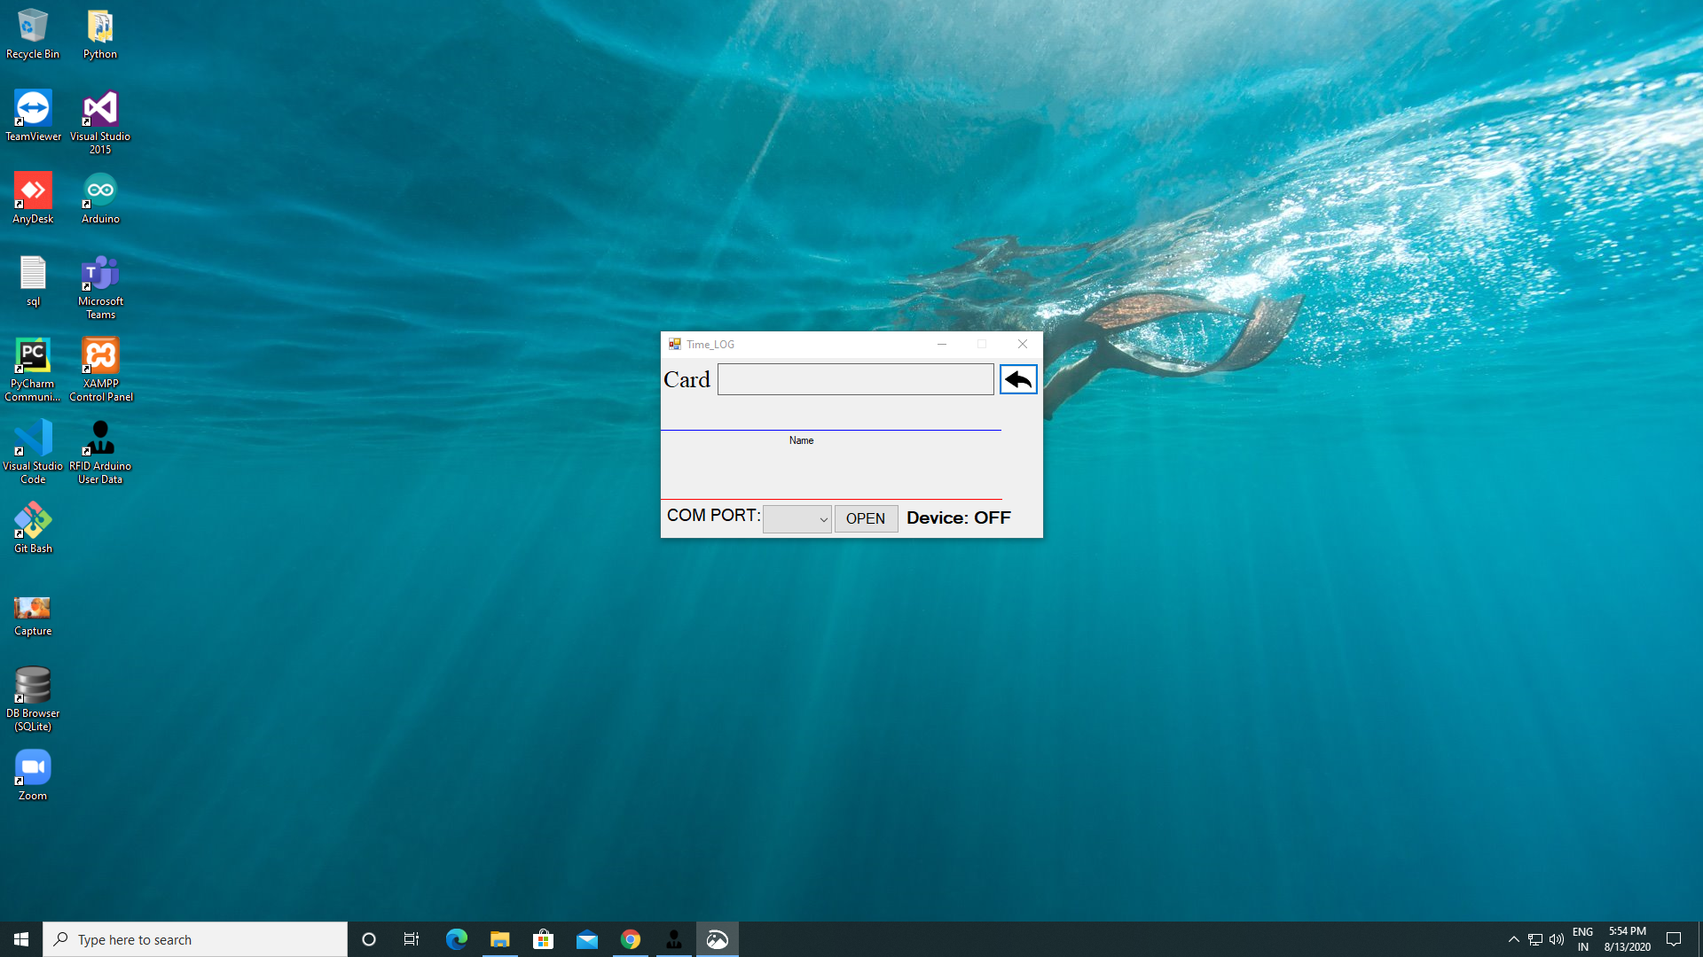
In/Out
Screen…
Place your screenshot here

Slide 29
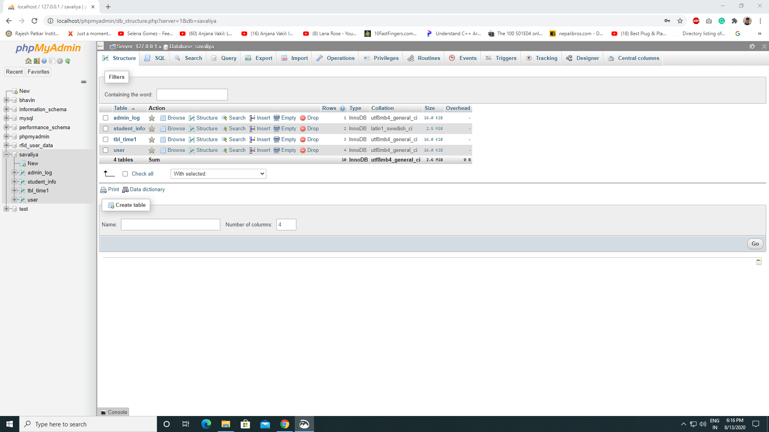
MySQL
Database
Screen…
Place your screenshot here

Slide 30
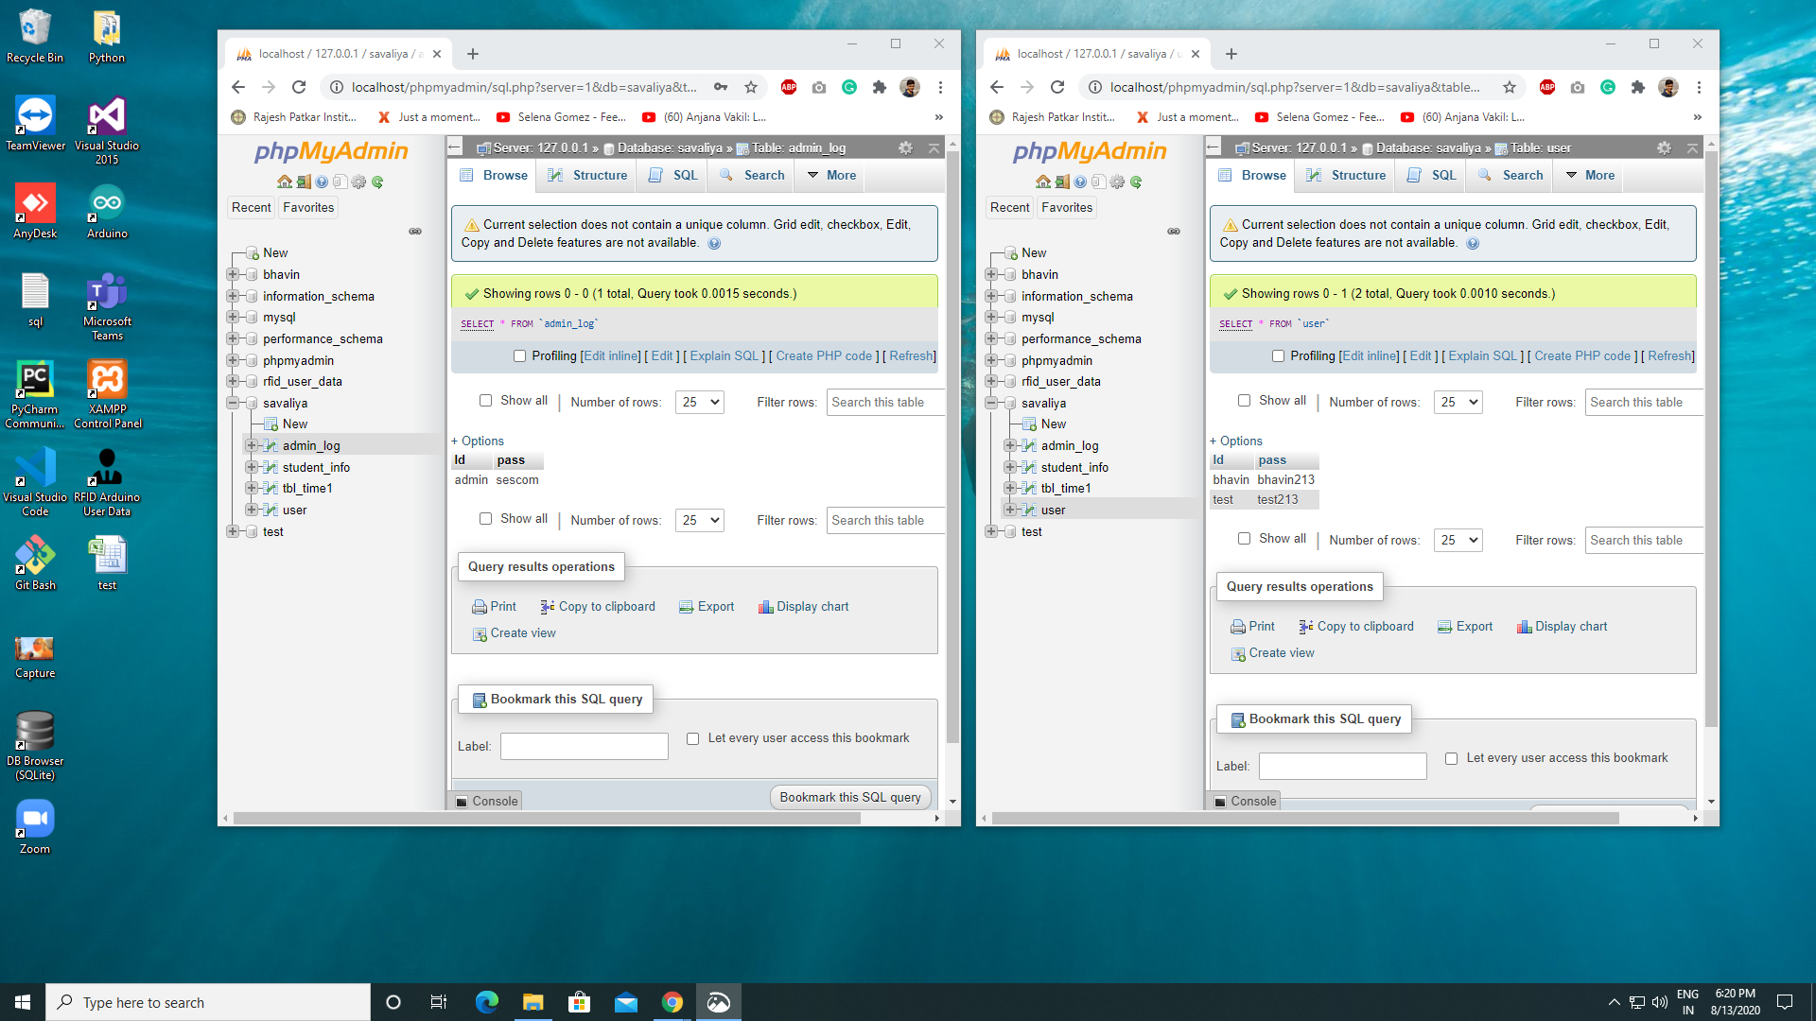
MySQL
admin & user
Screen…
Place your screenshot here

Slide 31
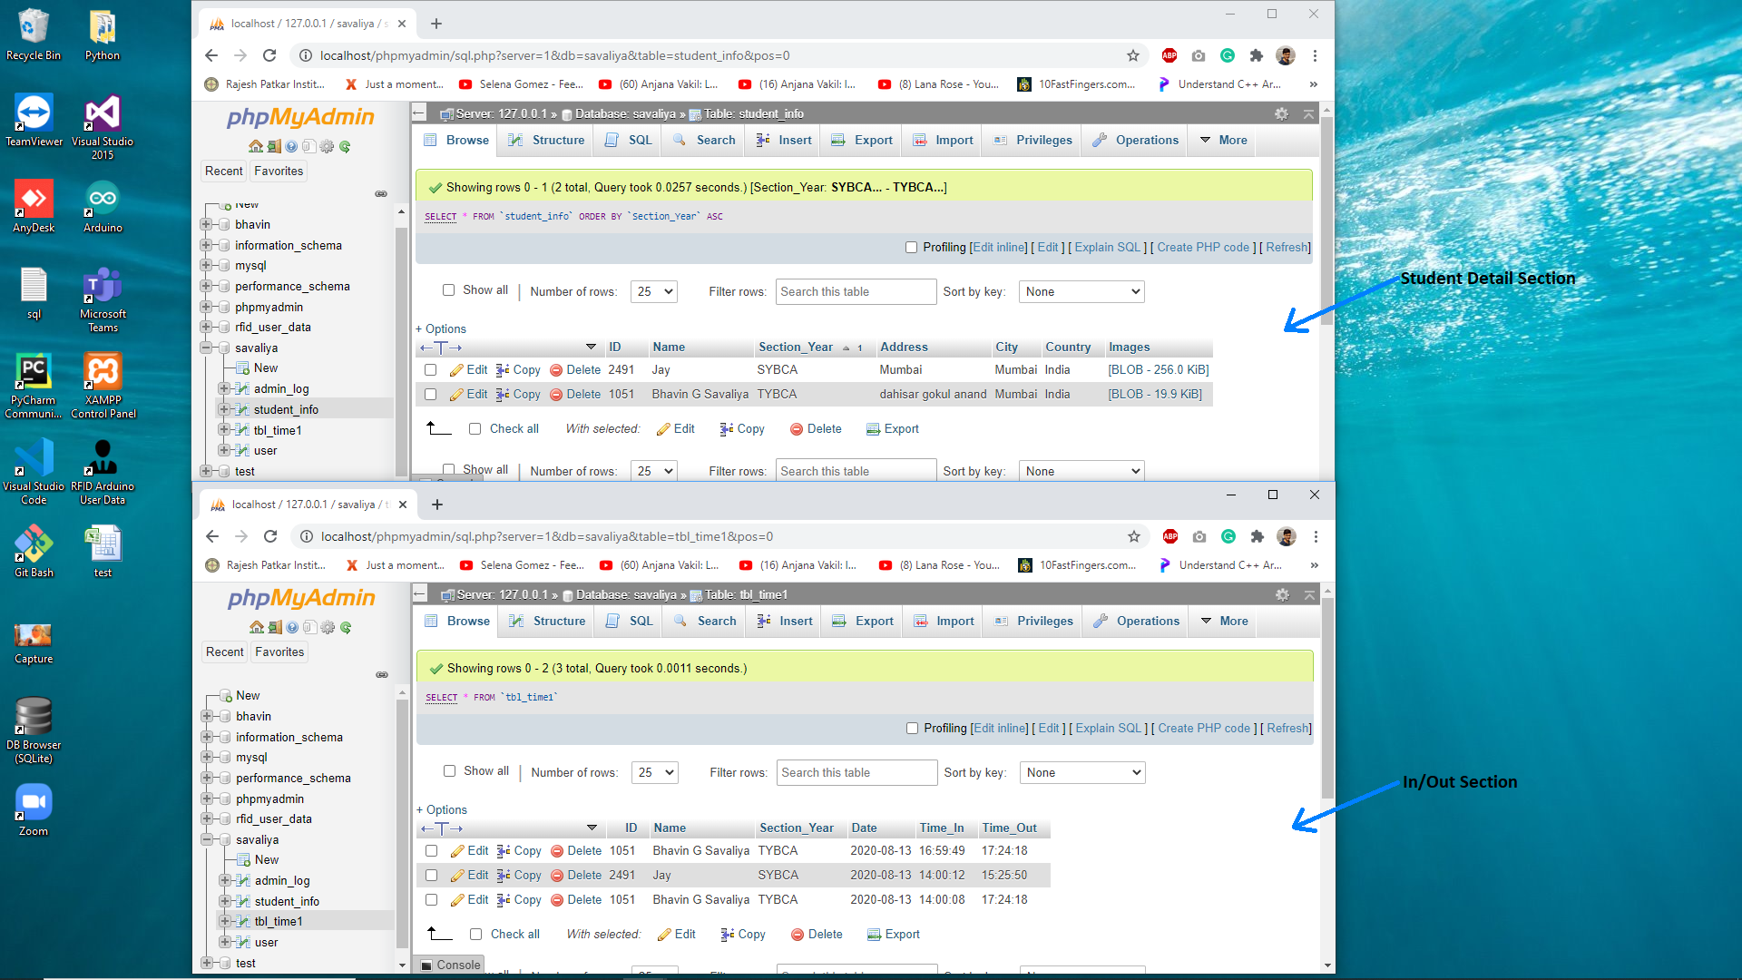
MySQL
Database
Table
Screen…
Place your screenshot here

Slide 32
Software Requirements :
Visual Studio 2015 Professional
.NET Framework 4.5.2
MySQL Connector/ODBC 8.0
XAMPP v.7.4.8 (MySQL Server)
Arduino v.1.8.13

Slide 33
THANK YOU!

